Slide 1
Python data structures

Slide 2
Data types
Python has five standard data types:
Numbers
String
List
Tuple
Dictionary

Slide 3
Types of Operator
Python language supports the following types of operators.
Arithmetic Operators
Comparison (Relational) Operators
Assignment Operators
Logical Operators
Bitwise Operators
Membership Operators
Identity Operators

Slide 4
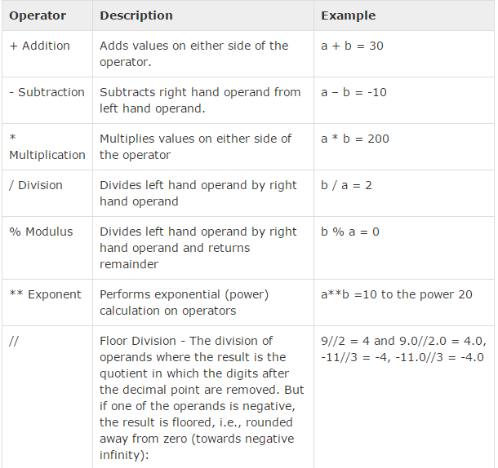
Arithmetic Op.
a = 10
b = 20

Slide 5
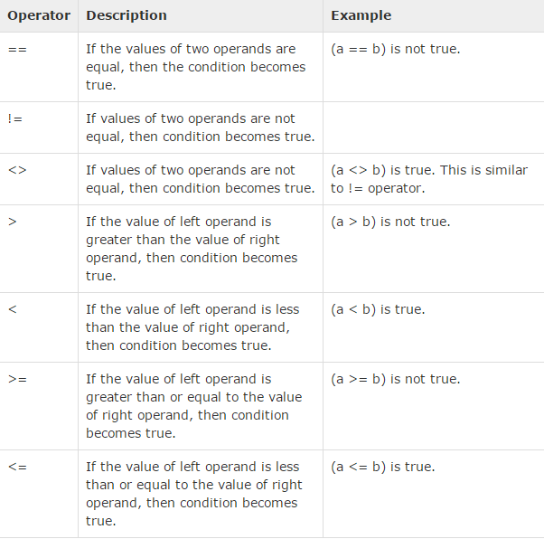
Comparison Op.
a = 10
b = 20

Slide 6
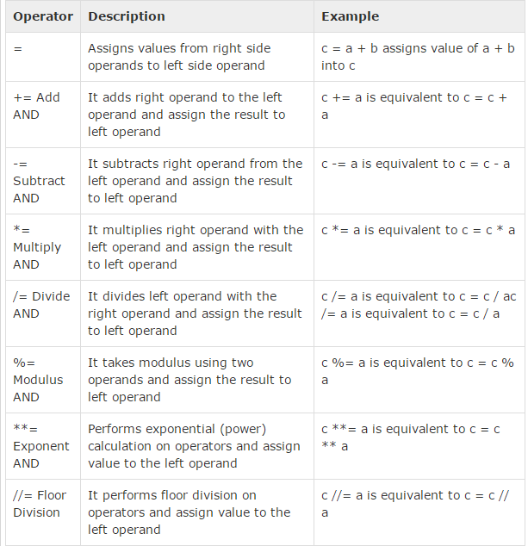
Assignment Op.

Slide 7
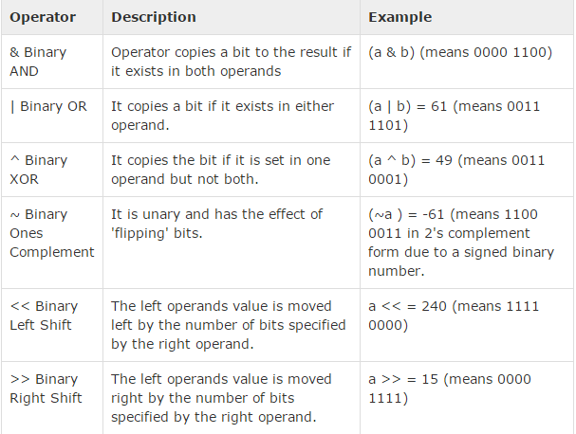
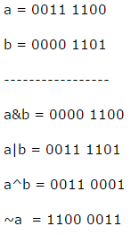
Bitwise Op.
Bitwise operator works on bits and
performs bit by bit operation.

Slide 8
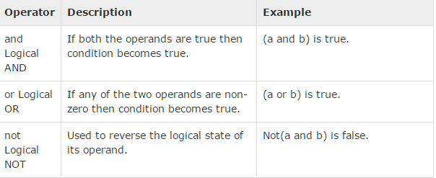
Logical Op.

Slide 9
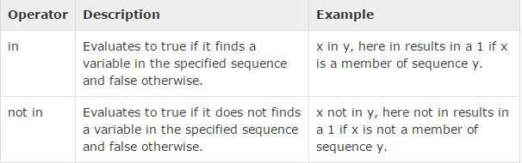
Membership Op.
Python’s membership operators test for membership in a sequence, such as strings, lists, or tuples.

Slide 10
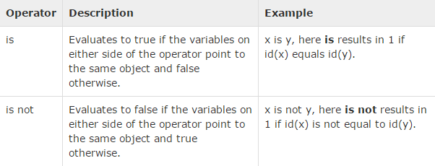
Identity Op.

Slide 11
Numbers
Number data types store numeric values. Number objects are created when you assign a value to them.
var1 = 1 var2 = 10
You can also delete the reference to a number object by using the del statement.
del var1[,var2[,var3[....,varN]]]]

Slide 12

Numbers cont.
Python supports four different numerical types −
int (signed integers)
long (long integers, they can also be represented in octal and hexadecimal)
float (floating point real values)
complex (complex numbers)

Slide 13
Number Type Conversion
Type int(x) to convert x to a plain integer.
Type long(x) to convert x to a long integer.
Type float(x) to convert x to a floating-point number.
Type complex(x) to convert x to a complex number with real part x and imaginary part zero.
Type complex(x, y) to convert x and y to a complex number with real part x and imaginary part y. x and y are numeric expressions

Slide 14
Mathematical Functions
abs(x)
The absolute value of x: the (positive) distance between x and zero.
ceil(x)
The ceiling of x: the smallest integer not less than x
cmp(x, y)
-1 if x < y, 0 if x == y, or 1 if x > y
exp(x)
The exponential of x: e^{x}

Slide 15
fabs(x)
The absolute value of x.
floor(x)
The floor of x: the largest integer not greater than x
log(x)
The natural logarithm of x, for x> 0
log10(x)
The base-10 logarithm of x for x> 0 .
max(x1, x2,...)
The largest of its arguments: the value closest to positive infinity
min(x1, x2,...)
The smallest of its arguments: the value closest to negative

Slide 16
modf(x)
The fractional and integer parts of x in a two-item tuple. Both parts have the same sign as x. The integer part is returned as a float.
pow(x, y)
The value of x**y.
round(x [,n])
x rounded to n digits from the decimal point. Python rounds away from zero as a tie-breaker: round(0.5) is 1.0 and round(-0.5) is -1.0.
sqrt(x)
The square root of x for x > 0
Python also has Trigonometric functions and has also two constants : pi and e

Slide 17
Strings
Strings in Python are identified as a contiguous set of characters represented in the quotation marks. Python allows for either pairs of single or double quotes. Subsets of strings can be taken using the slice operator ([ ] and [:] ) with indexes starting at 0 in the beginning of the string and working their way from -1 at the end.
The plus (+) sign is the string concatenation operator and the asterisk (*) is the repetition operator.
Strings are amongst the most popular types in Python. We can create them simply by enclosing characters in quotes. Python treats single quotes the same as double quotes. Creating strings is as simple as assigning a value to a variable.

Slide 18
Strings overview.
str = 'Hello World!' print str # Prints complete string print str[0] # Prints first character of the string print str[2:5] # Prints characters starting from 3rd to 5th print str[2:] # Prints string starting from 3rd character print str * 2 # Prints string two times print str + "TEST" # Prints concatenated string
Hello World! H llo llo World! Hello World!Hello World! Hello World!TEST

Slide 19
Accessing Values in Strings
#!/usr/bin/python var1 = 'Hello World!' var2 = "Python Programming" print "var1[0]: ", var1[0] print "var2[1:5]: ", var2[1:5]
var1[0]: H var2[1:5]: ytho

Slide 20
Updating Strings
#!/usr/bin/python var1 = 'Hello World!' print "Updated String :- ", var1[:6] + 'Python'
Updated String :- Hello Python

Slide 21
Escape Characters
\a - bell alert
\b - backspace
\cx - control x
\c-x - control x
\e - escape
\f - formfeed
\n - newline
\r - carriage return
\s - space
\t - tab
\v - vertical tab
\x - character x

Slide 22
Concatenation - Adds values on either side of the operator
a + b will give HelloPython
* Repetition - Creates new strings, concatenating multiple copies of the same string
a*2 will give -HelloHello
[] Slice - Gives the character from the given index
a[1] will give e
[ : ] Range Slice - Gives the characters from the given range
a[1:4] will give ell
In Membership - Returns true if a character exists in the given string
H in a will give 1
Not In Membership - Returns true if a character does not exist in the given string
M not in a will give 1

Slide 23
r/R Raw string
Raw String - Suppresses actual meaning of Escape characters. The syntax for raw strings is exactly the same as for normal strings with the exception of the raw string operator, the letter "r," which precedes the quotation marks. The "r" can be lowercase (r) or uppercase (R) and must be placed immediately preceding the first quote mark.
print r'\n' prints \n and print R'\n'prints \n
% Format - Performs String formatting

Slide 24
String Formatting Operator %
#!/usr/bin/python print "My name is %s and weight is %d kg!" % ('Zara', 21)
My name is Zara and weight is 21 kg!
%c - character
%s - string conversion via str() prior to formatting
%i - signed decimal integer
%d - signed decimal integer
%u - unsigned decimal integer
%o - octal integer
%x - hexadecimal integer (lowercase letters)
%X - hexadecimal integer (UPPERcase letters)
%e - exponential notation (with lowercase 'e')
%E - exponential notation (with UPPERcase 'E')
%f - floating point real number

Slide 25
Raw string
Raw strings do not treat the backslash as a special character at all. Every character you put into a raw string stays the way you wrote it.
#!/usr/bin/python print 'C:\\nowhere'
C:\nowhere
#!/usr/bin/python print r'C:\\nowhere'
C:\\nowhere

Slide 26
Unicode String
Normal strings in Python are stored internally as 8-bit ASCII, while Unicode strings are stored as 16-bit Unicode.
#!/usr/bin/python print u'Hello, world!'

Slide 27
PYTHON STRING CONVERSION FUNCTIONS
capitalize()
lower()
upper()
swapcase()
title()
count( str[,beg [,end]])

Slide 28
var = ‘welcome to Python programming’
print (var.title())
# Welcome To Python Programming
var = ‘PYTHON’
print (var.capitalize())
# Python
var = ‘TechBeamers’
print (var.lower())
# techbeamers
var = ‘TechBeamers’
print (var.swapcase())
# tECHbEAMERS
var = ‘TechBeamers’
print (var.upper())
# TECHBEAMERS
var=’TechBeamers’
str=’e’
print (var.count(str))
# 3

Slide 29
PYTHON STRINGS COMPARISON FUNCTIONS
islower()
isupper()
isdecimal()
isdigit()
isnumeric()
isalpha()
isalnum()

Slide 30
islower()
Returns True if all the characters in the String are in lowercase. If any one character is in uppercase it will return False.
isupper()
Returns True if all the characters in the String are in uppercase. If any one character is in lowercase it will return False.
isdecimal()
Returns ‘True’ if all the characters in String are decimal. If anyone character in the String is of other data-type, it will return ‘False’.
Decimal characters are those from Unicode category ‘Nd’.
Complete list of ‘Nd’ is present at following link: http://www.fileformat.info/info/unicode/category/Nd/list.htm
isdigit()
Returns ‘True’ for any character for which isdecimal() would return ‘True and some characters in ‘No’ category.
No categories: http://www.fileformat.info/info/unicode/category/No/list.htm
isnumeric()
Returns ‘True’ if all the characters of the Unicode String lie in any one of the category ‘Nd’,’No’ and ‘NI’.
Ni categories: http://www.fileformat.info/info/unicode/category/Nl/list.htm
isalpha()
Returns True if String contains at least one character (non-empty String) and all the characters are alphabetic, False otherwise.
isalnum()
Returns True if String contains at least one character (non-empty String) and all the characters are either alphabetic or decimal digits, False otherwise.

Slide 31
islower()
isupper()
isdecimal()
isalnum()
var=’Python’
print (var.islower())
# False
var=’python’
print (var.islower())
# True
var=’Python’
print (var.isupper())
# False
var=’PYTHON’
print (var.isupper())
# True
num=u’2016′
print (num.isdecimal())
# True
print (‘python’.isalnum())
# True
print (‘python3’.isalnum())
# True
isdigit()
isnumeric()
isalpha()
print (‘2’.isdigit())
# True
print (‘²’.isdigit())
# True
num=u’2016′
print (num.isnumeric())
# True
num=u’year2016′
print (num.isnumeric())
# False
print (‘python’.isalpha())
# True
print (‘python3’.isalpha())
# False

Slide 32
PYTHON STRING PADDING FUNCTIONS
rjust(width[,fillchar])
ljust(width[,fillchar])
center(width[,fillchar])
zfill(width)

Slide 33
rjust(width,[fill])
rjust(width,[fill])
rjust(width,[fill])
rjust(width,[fill])
var=’Python’
print (var.rjust(10))
# Python
var=’Python’
print (var.ljust(10))
# Python
print (var.ljust(10,’-‘))
# Python—-
var=’Python’
print (var.center(20))
# Python
print (var.center(20,’*’))
# *******Python*******
var=’Python’
print (var.zfill(10))
# 0000Python
var=’+Python’
print (var.zfill(10))
# +000Python

Slide 34
FUNCTIONS TO FIND A STRING IN PYTHON
find(str [,i [,j]])
index(str[,i [,j]])
rfind(str[,i [,j]])
count(str[,i [,j]])
i=search starts from this index
j=search ends at this index.

Slide 35
find(str,[i,[j]])
Searches for str in complete String (if i and j not defined) or in a sub-string of String (if i and j are defined).This function returns the index if str is found else returns -1.
where,
i=search starts from this index
j=search ends at this index.
var=”Tech Beamers”
str=”Beam”
print (var.find(str))
# 5
var=”Tech Beamers”
str=”Beam”
print (var.find(str,4))
# 5
var=”Tech Beamers”
str=”Beam”
print (var.find(str,7))
# -1

Slide 36
index(str,[i,[j]])
This is same as find method. The only difference is that it raises ValueError exception if str is not found.
var=’Tech Beamers’
str=’Beam’
print (var.index(str))
# 5
var=’Tech Beamers’
str=’Beam’
print (var.index(str,4))
# 5
var=’Tech Beamers’
str=’Beam’
print (var.index(str,7))
# ValueError: substring not found

Slide 37
rfind(str,[i,[j]])
This is same as find() just that this function returns the last index where str is found. If str is not found it returns -1.
var=’This is a good example’
str=’is’
print (var.rfind(str,0,10))
# 5
print (var.rfind(str,10))
# -1

Slide 38
count(str,[i,[j]])
Returns the number of occurrences of substring str in the String.
var=’This is a good example’
str=’is’
print (var.count(str))
# 2
print (var.count(str,4,10))
# 1

Slide 39
FUNCTIONS TO REPLACE A STRING IN PYTHON
replace(old,new[,count])
split([sep[,maxsplit]])
splitlines(num)
join(seq)

Slide 40
replace(old,new,[count])
Replaces all the occurrences of substring old with new in the String.
If count is defined then only count number of occurrences of old will be replaced with new.
where,
old =substring to be replaced
new =substring that will replace the old
count =number of occurrences of old that will be replaced with new.
var=’This is a good example’
str=’was’
print (var.replace(‘is’,str))
# Thwas was a good exampleprint (var.replace(‘is’,str,1))
# Thwas is a good example

Slide 41
split(sep,[maxsplit])
Returns a list of substring obtained after splitting the String with sep as delimiter.
where,
sep= delimiter, default is space
maxsplit= number of splits to be done
var = “This is a good example”
print (var.split())
# [‘This’, ‘is’, ‘a’, ‘good’, ‘example’]
print (var.split(‘ ‘, 3))
# [‘This’, ‘is’, ‘a’, ‘good example’]

Slide 42
splitlines(num)
Splits the String at line breaks and returns the list after removing the line breaks.
where,
num = if this is positive value. It indicates that line breaks to be included in the returned list.
var=’Print new line\nNextline\n\nMove again to new line’
print (var.splitlines())
# [‘Print new line’, ‘Nextline’, ”, ‘Move again to new line’]
print (var.splitlines(1))
# [‘Print new line\n’, ‘Nextline\n’, ‘\n’, ‘Move again to new line’]

Slide 43
join(seq)
Returns a String obtained after concatenating the sequence seq with a delimiter string.
where,
seq= sequence of elements to be joined
seq=(‘ab’,’bc’,’cd’)
str=’=’
print (str.join(seq))
# ab=bc=cd

Slide 44
MISC STRING HANDLING FUNCTIONS IN PYTHON
lstrip([chars])
rstrip([chars])
rindex(str[,i [,j]])
len(string)

Slide 45
lstrip - Returns a String after removing the characters from the beginning of the String.
Chars=this is the character to be trimmed from the String. Default is whitespace character.
rstrip - Returns a String after removing the characters from the End of the String.
Chars=this is the character to be trimmed from the String. Default is whitespace character.
strip - Returns a String after removing the characters from the Begining - End of the String.
Chars=this is the character to be trimmed from the String. Default is whitespace character.
rindex - Searches for str in complete String (if i and j not defined) or in a sub-string of String (if i and j are defined).This function returns the last index where str is found.
If str is not found it raises ValueError exception.
len - Returns the length of given String

Slide 46
lstrip([chars])
strip([chars])
rindex(str,[i,[j]])
len(string)
var=’ This is a good example ‘
print (var.lstrip())
# This is a good example
var=’*****This is a good example*****’
print (var.lstrip(‘*’))
# This is a good example**********
var=’ This is a good example ‘
print (var.rstrip())
# This is a good example
var=’*****This is a good example*****’
print (var.lstrip(‘*’))
# *****This is a good example
var=’This is a good example’
str=’is’
print (var.rindex(str,0,10))
# 5
print (var.rindex(str,10))
# ValueError: substring not found
var=’This is a good example’
print (len(var))
# 22

Slide 47
Lists
Lists are the most versatile of Python's compound data types. A list contains items separated by commas and enclosed within square brackets ([]). To some extent, lists are similar to arrays in C. One difference between them is that all the items belonging to a list can be of different data type.
The values stored in a list can be accessed using the slice operator ([ ] and [:]) with indexes starting at 0 in the beginning of the list and working their way to end -1. The plus (+) sign is the list concatenation operator, and the asterisk (*) is the repetition operator.

Slide 48
Access elements in list
#!/usr/bin/python list = [ 'abcd', 786 , 2.23, 'john', 70.2 ] tinylist = [123, 'john'] print list # Prints complete list print list[0] # Prints first element of the list print list[1:3] # Prints elements starting from 2nd till 3rd print list[2:] # Prints elements starting from 3rd element print tinylist * 2 # Prints list two times print list + tinylist # Prints concatenated lists
['abcd', 786, 2.23, 'john', 70.200000000000003] abcd [786, 2.23] [2.23, 'john', 70.200000000000003] [123, 'john', 123, 'john'] ['abcd', 786, 2.23, 'john', 70.200000000000003, 123, 'john']

Slide 49
Update elements
#!/usr/bin/python list = ['physics', 'chemistry', 1997, 2000]; print "Value available at index 2 : " print list[2] list[2] = 2001; print "New value available at index 2 : " print list[2]
Value available at index 2 : 1997 New value available at index 2 : 2001

Slide 50
Delete elements
#!/usr/bin/python list1 = ['physics', 'chemistry', 1997, 2000]; print list1 del list1[2]; print "After deleting value at index 2 : " print list1
['physics', 'chemistry', 1997, 2000] After deleting value at index 2 : ['physics', 'chemistry', 2000]

Slide 51
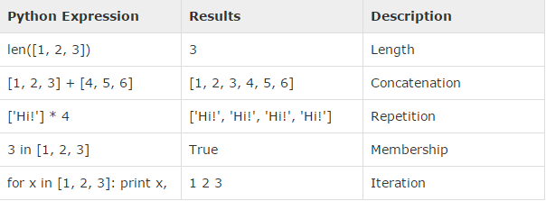
List basic operations

Slide 52
Built-in list functions
cmp(list1,list2)
len(list)
max(list)
min(list)
list(seq)

Slide 53
cmp(list1,list2)
#!/usr/bin/python list1, list2 = [123, 'xyz'], [456, 'abc'] print cmp(list1, list2) print cmp(list2, list1) list3 = list2 + [786]; print cmp(list2, list3)
-1 1 -1
Compare the two objects x and y and return an integer according to the outcome. The return value is negative if x < y, zero if x == y and strictly positive if x > y.

Slide 54
len(list)
max(list)
#!/usr/bin/python list1, list2 = [123, 'xyz', 'zara'], [456, 'abc'] print "First list length : ", len(list1) print "Second list length : ", len(list2)
First list length : 3 Second list length : 2
#!/usr/bin/python list1, list2 = [123, 'xyz', 'zara', 'abc'], [456, 700, 200] print "Max value element : ", max(list1) print "Max value element : ", max(list2)
Max value element : zara Max value element : 700

Slide 55
min(list)
list(seq)
#!/usr/bin/python list1, list2 = [123, 'xyz', 'zara', 'abc'], [456, 700, 200] print "min value element : ", min(list1) print "min value element : ", min(list2)
min value element : 123 min value element : 200
#!/usr/bin/python aTuple = (123, 'xyz', 'zara', 'abc'); aList = list(aTuple) print "List elements : ", aList
List elements : [123, 'xyz', 'zara', 'abc']

Slide 56
List functions
list.append(obj)
list.count(obj)
list.extend(seq)
list.index(obj)
list.insert(index,obj)
list.pop(obj=list[-1])
list.remove(obj)
list.reverse()
list.sort()

Slide 57
list.append(obj)
list.count(obj)
#!/usr/bin/python aList = [123, 'xyz', 'zara', 'abc']; aList.append( 2009 ); print "Updated List : ", aList
Updated List : [123, 'xyz', 'zara', 'abc', 2009]
#!/usr/bin/python aList = [123, 'xyz', 'zara', 'abc', 123]; print "Count for 123 : ", aList.count(123) print "Count for zara : ", aList.count('zara')
Count for 123 : 2 Count for zara : 1

Slide 58
list.extend(seq)
list.index(obj)
#!/usr/bin/python aList = [123, 'xyz', 'zara', 'abc', 123]; bList = [2009, 'manni']; aList.extend(bList) print "Extended List : ", aList
Extended List : [123, 'xyz', 'zara', 'abc', 123, 2009, 'manni']
#!/usr/bin/python aList = [123, 'xyz', 'zara', 'abc']; print "Index for xyz : ", aList.index( 'xyz' ) print "Index for zara : ", aList.index( 'zara' )
Index for xyz : 1 Index for zara : 2

Slide 59
list.insert(index,obj)
list.pop(list[-1])
#!/usr/bin/python aList = [123, 'xyz', 'zara', 'abc'] aList.insert( 3, 2009) print "Final List : ", aList
Final List : [123, 'xyz', 'zara', 2009, 'abc']
#!/usr/bin/python aList = [123, 'xyz', 'zara', 'abc']; print "A List : ", aList.pop() print "B List : ", aList.pop(2)
A List : abc B List : zara

Slide 60
list.remove(obj)
list.reverse()
#!/usr/bin/python aList = [123, 'xyz', 'zara', 'abc', 'xyz']; aList.remove('xyz'); print "List : ", aList
List : [123, 'zara', 'abc', 'xyz']
#!/usr/bin/python aList = [123, 'xyz', 'zara', 'abc', 'xyz']; aList.reverse(); print "List : ", aList
List : ['xyz', 'abc', 'zara', 'xyz', 123]

Slide 61
list.sort([func])
#!/usr/bin/python aList = [123, 'xyz', 'zara', 'abc', 'xyz']; aList.sort(); print "List : ", aList
List : [123, 'abc', 'xyz', 'xyz', 'zara']

Slide 62
Tuples
A tuple is another sequence data type that is similar to the list. A tuple consists of a number of values separated by commas. Unlike lists, however, tuples are enclosed within parentheses.
The main differences between lists and tuples are: Lists are enclosed in brackets ( [ ] ) and their elements and size can be changed, while tuples are enclosed in parentheses ( ( ) ) and cannot be updated. Tuples can be thought of as read-only lists.

Slide 63
Tuples cont.
#!/usr/bin/python tuple = ( 'abcd', 786 , 2.23, 'john', 70.2 ) tinytuple = (123, 'john') print tuple # Prints complete list print tuple[0] # Prints first element of the list print tuple[1:3] # Prints elements starting from 2nd till 3rd print tuple[2:] # Prints elements starting from 3rd element print tinytuple * 2 # Prints list two times print tuple + tinytuple # Prints concatenated lists
('abcd', 786, 2.23, 'john', 70.200000000000003) abcd (786, 2.23) (2.23, 'john', 70.200000000000003) (123, 'john', 123, 'john') ('abcd', 786, 2.23, 'john', 70.200000000000003, 123, 'john')

Slide 64
Tuple cont.
The following code is invalid with tuple, because we attempted to update a tuple, which is not allowed. Similar case is possible with lists −
#!/usr/bin/python tuple = ( 'abcd', 786 , 2.23, 'john', 70.2 ) list = [ 'abcd', 786 , 2.23, 'john', 70.2 ] tuple[2] = 1000 # Invalid syntax with tuple list[2] = 1000 # Valid syntax with list

Slide 65
Delete elements
#!/usr/bin/python tup = ('physics', 'chemistry', 1997, 2000); print tup del tup; print "After deleting tup : " print tup
('physics', 'chemistry', 1997, 2000) After deleting tup : Traceback (most recent call last): File "test.py", line 9, in <module> print tup; NameError: name 'tup' is not defined

Slide 66
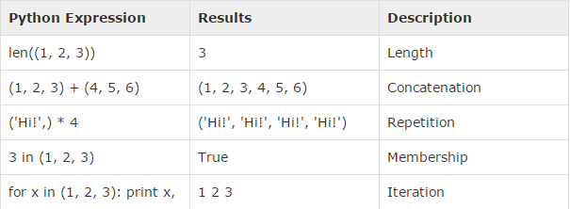
Tuple basic operations

Slide 67
Built-in tuple functions
cmp(tuple1,tuple2)
len(tuple)
max(tuple)
min(tuple)
list(seq)

Slide 68
Dictionary
Python's dictionaries are kind of hash table type. They work like associative arrays or hashes found in Perl and consist of key-value pairs. A dictionary key can be almost any Python type, but are usually numbers or strings. Values, on the other hand, can be any arbitrary Python object.
Dictionaries are enclosed by curly braces ({ }) and values can be assigned and accessed using square braces ([]).

Slide 69
Access elements in dict
#!/usr/bin/python dict = {} dict['one'] = "This is one" dict[2] = "This is two" tinydict = {'name': 'john','code':6734, 'dept': 'sales'} print dict['one'] # Prints value for 'one' key print dict[2] # Prints value for 2 key print tinydict # Prints complete dictionary print tinydict.keys() # Prints all the keys print tinydict.values() # Prints all the values

Slide 70
This is one This is two {'dept': 'sales', 'code': 6734, 'name': 'john'} ['dept', 'code', 'name'] ['sales', 6734, 'john']
Dictionaries have no concept of order among elements.

Slide 71
Update elements
#!/usr/bin/python dict = {'Name': 'Zara', 'Age': 7, 'Class': 'First'} dict['Age'] = 8; # update existing entry dict['School'] = "DPS School"; # Add new entry print "dict['Age']: ", dict['Age'] print "dict['School']: ", dict['School']
dict['Age']: 8 dict['School']: DPS School

Slide 72
Delete elements
#!/usr/bin/python dict = {'Name': 'Zara', 'Age': 7, 'Class': 'First'} del dict['Name']; # remove entry with key 'Name' dict.clear(); # remove all entries in dict del dict ; # delete entire dictionary print "dict['Age']: ", dict['Age'] print "dict['School']: ", dict['School']
dict['Age']: Traceback (most recent call last): File "test.py", line 8, in <module> print "dict['Age']: ", dict['Age']; TypeError: 'type' object is unsubscriptable

Slide 73
Properties of dict keys
Dictionary values have no restrictions. They can be any arbitrary Python object, either standard objects or user-defined objects.
More than one entry per key not allowed. Which means no duplicate key is allowed. When duplicate keys encountered during assignment, the last assignment wins.
Keys must be immutable. Which means you can use strings, numbers or tuples as dictionary keys.
mydict = {}
mydict[1] = 1
mydict['1'] = '1'
mydict[('a','ab')] = 'a'
print mydict['1']
print mydict[1]
print mydict[('a','ab')]
1
1
a

Slide 74
Built-in tuple functions
cmp(dict1,dict2)
len(dict)
str(dict)
type(dict)

Slide 75
Dictionary methods
dict.clear()
dict.copy()
dict.fromkeys()
dict.get(key,default=None)
dict.has_key(key)
dict.items()
dict.keys()
dict.setdefault(key,default=None)
dict.update(dict2)
dict.values()

Slide 76
dict.clear()
dict.copy()
#!/usr/bin/python dict = {'Name': 'Zara', 'Age': 7}; print "Start Len : %d" % len(dict) dict.clear() print "End Len : %d" % len(dict)
Start Len : 2 End Len : 0
#!/usr/bin/python dict1 = {'Name': 'Zara', 'Age': 7}; dict2 = dict1.copy() print "New Dictinary : %s" % str(dict2)
New Dictinary : {'Age': 7, 'Name': 'Zara'}

Slide 77
dict.fromkeys(seq,[,value])
dict.get(key,default=None)
#!/usr/bin/python seq = ('name', 'age') dict = dict.fromkeys(seq) print "New Dictionary : %s" % str(dict) dict = dict.fromkeys(seq, 10) print "New Dictionary : %s" % str(dict)
New Dictionary : {'age': None, 'name': None} New Dictionary : {'age': 10, 'name': 10}
#!/usr/bin/python dict = {'Name': 'Zabra', 'Age': 7} print "Value : %s" % dict.get('Age') print "Value : %s" % dict.get('Education', "Never")
Value : 7 Value : Never

Slide 78
dict.has_key(key)
dict.items()
#!/usr/bin/python dict = {'Name': 'Zara', 'Age': 7} print "Value : %s" % dict.has_key('Age')
Value : True
#!/usr/bin/python dict = {'Name': 'Zara', 'Age': 7} print "Value : %s" % dict.items()
Value : [('Age', 7), ('Name', 'Zara')]

Slide 79
dict.keys()
dict.values()
#!/usr/bin/python dict = {'Name': 'Zara', 'Age': 7} print "Value : %s" % dict.keys()
Value : ['Age', 'Name']
#!/usr/bin/python dict = {'Name': 'Zara', 'Age': 7} print "Value : %s" % dict.values()
Value : [7, 'Zara']

Slide 80
dict.setdefault(key,default=None)
dict.update(dict2)
#!/usr/bin/python dict = {'Name': 'Zara', 'Age': 7} print "Value : %s" % dict.setdefault('Age', None) print "Value : %s" % dict.setdefault('Gender', None)
Value : 7 Value : None
#!/usr/bin/python dict = {'Name': 'Zara', 'Age': 7} dict2 = {'Gender': 'female' } dict.update(dict2) print "Value : %s" % dict
Value : {'Age': 7, 'Name': 'Zara', 'Gender': 'female'}

Slide 81
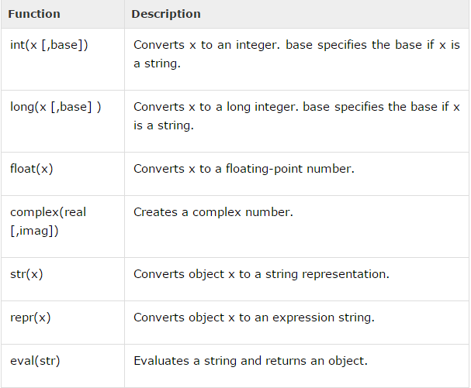
Data Type Conversion

Slide 82
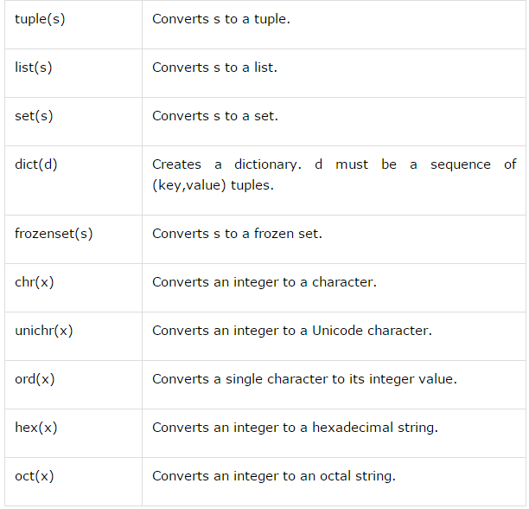
Data Type Conversion

Slide 83
Loops
While loop
For loop
Nested loop

Slide 84
Control Statements
break
continue
Pass
Break - Terminates the loop statement and transfers execution to the statement immediately following the loop.
Continue - Causes the loop to skip the remainder of its body and immediately retest its condition prior to reiterating.
Pass - The pass statement in Python is used when a statement is required syntactically but you do not want any command or code to execute.

Slide 85
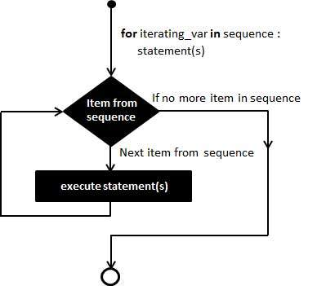
for loop
for iterating_var in sequence: statements(s)
sequence = string,list,tuple,dictionary..
#!/usr/bin/python for letter in 'Python': # First Example print 'Current Letter :', letter fruits = ['banana', 'apple', 'mango'] for fruit in fruits: # Second Example print 'Current fruit :', fruit print "Good bye!"

Slide 86
Iterating by Sequence Index
#!/usr/bin/python fruits = ['banana', 'apple', 'mango'] for index in range(len(fruits)): print 'Current fruit :', fruits[index] print "Good bye!"
Current fruit : banana Current fruit : apple Current fruit : mango Good bye!

Slide 87
Using else Statement with Loops
for item in container: if search_something(item): # Found it! process(item) break else: # Didn't find anything.. not_found_in_container()
For loops also have an else clause which most of us are unfamiliar with. The else clause executes when the loop completes normally. This means that the loop did not encounter any break.

Slide 88
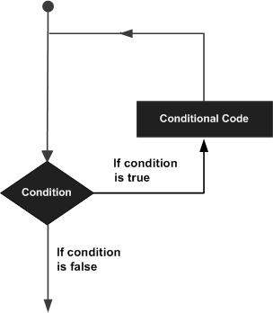
while loop
while expression: statement(s)
#!/usr/bin/python count = 0 while (count < 9): print 'The count is:', count count = count + 1 print "Good bye!"
The count is: 0 The count is: 1 The count is: 2 The count is: 3 The count is: 4 The count is: 5 The count is: 6 The count is: 7 The count is: 8 Good bye!

Slide 89
while else
#!/usr/bin/python count = 0 while count < 5: print count, " is less than 5" count = count + 1 else: print count, " is not less than 5"
If the else statement is used with a while loop, the else statement is executed when the condition becomes false.
Single statement
#!/usr/bin/python flag = 1 while (flag): print 'Given flag is really true!' print "Good bye!"

Slide 90
nested loops
for iterating_var in sequence: for iterating_var in sequence: statements(s) statements(s)
for x in range(1, 11):
for y in range(1, 11):
print '%d * %d = %d' % (x, y, x*y)
1 * 1 = 1
1 * 2 = 2
1 * 3 = 3
1 * 4 = 4
1 * 5 = 5
1 * 6 = 6
1 * 7 = 7
1 * 8 = 8
1 * 9 = 9
1 * 10 = 10
…
10 * 10 = 100
while expression: while expression: statement(s) statement(s)

Slide 91
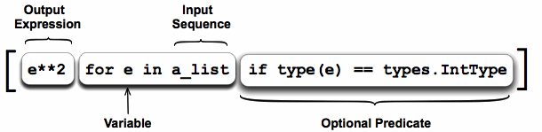
list comprehensions
Comprehensions are constructs that allow sequences to be built from other sequences.
List comprehensions provide a concise way to create lists.

Slide 92
characters = []
for i in range(65,91):
characters.append(chr(i))
print characters
['A', 'B', 'C', 'D', 'E', 'F', 'G', 'H', 'I', 'J', 'K', 'L', 'M', 'N', 'O', 'P', 'Q', 'R', 'S', 'T', 'U', 'V', 'W', 'X', 'Y', 'Z']
print [chr(x) for x in range(65,91)]
characters = []
for i in range(65,91):
for j in range(65,91):
characters.append(chr(i)+chr(j))
print characters
['AA', 'AB', 'AC', 'AD', 'AE', 'AF', 'AG', 'AH', 'AI', 'AJ', 'AK', 'AL',...,'ZZ']
print [chr(x)+chr(y) for x in range(65,91) for y in range(65,91)]
print [str(x).strip() for x in open(‘file.txt’,’r’)]
[double(x) for x in range(10) if x%2==0]
THE SAME WORKS ALSO FOR TUPLES AND DICTIONARIES.

Slide 93
Regular expressions
A regular expression is a special sequence of characters that helps you match or find other strings or sets of strings, using a specialized syntax held in a pattern.
Methods:
Match
Search
Replace
Flags:
re.I
re.L
re.M
re.S
re.U
re.X

Slide 94
import re patterns = [ 'this', 'that' ] text = 'Does this text match the pattern?' for pattern in patterns: print 'Looking for "%s" in "%s" ->' % (pattern, text), if re.search(pattern, text): print 'found a match!' else: print 'no match'
Looking for "this" in "Does this text match the pattern?" -> found a match! Looking for "that" in "Does this text match the pattern?" -> no match
import re pattern = 'this' text = 'Does this text match the pattern?' match = re.search(pattern, text) s = match.start() e = match.end() print 'Found "%s" in "%s" from %d to %d ("%s")' % \ (match.re.pattern, match.string, s, e, text[s:e])
Found "this" in "Does this text match the pattern?" from 5 to 9 ("this")

Slide 95
import re # Pre-compile the patterns regexes = [ re.compile(p) for p in [ 'this', 'that', ] ] text = 'Does this text match the pattern?' for regex in regexes: print 'Looking for "%s" in "%s" ->' % (regex.pattern, text), if regex.search(text): print 'found a match!' else: print 'no match'
Looking for "this" in "Does this text match the pattern?" -> found a match! Looking for "that" in "Does this text match the pattern?" -> no match
import re text = 'abbaaabbbbaaaaa' pattern = 'ab' for match in re.findall(pattern, text): print 'Found "%s"' % match
Found "ab" Found "ab"

Slide 96
import re text = 'abbaaabbbbaaaaa' pattern = 'ab' for match in re.finditer(pattern, text): s = match.start() e = match.end() print 'Found "%s" at %d:%d' % (text[s:e], s, e)
Found "ab" at 0:2 Found "ab" at 5:7
str = 'purple alice-b@google.com monkey dishwasher'
match = re.search('([\w.-]+)@([\w.-]+)', str)
if match:
print match.group() ## 'alice-b@google.com' (the whole match)
print match.group(1) ## 'alice-b' (the username, group 1)
print match.group(2) ## 'google.com' (the host, group 2)
str = 'purple alice@google.com, blah monkey bob@abc.com blah dishwasher'
## re.sub(pat, replacement, str) -- returns new string with all replacements,
## \1 is group(1), \2 group(2) in the replacement
print re.sub(r'([\w\.-]+)@([\w\.-]+)', r'\1@yo-yo-dyne.com', str)
## purple alice@yo-yo-dyne.com, blah monkey bob@yo-yo-dyne.com blah dishwasher

Slide 97
Questions ?

